Slide 1
Chapter 5
BRAND EXPRESSION

Slide 2
Chapter 5.1
Speaking in the VOYO Way

Slide 3

Brand Personality and Voice
VOYO communicates as a familiar local presence, a streaming service that feels close to the viewer’s world.
We speak with warmth, energy, and emotional relevance, creating entertainment moments people want to share.
Our communication is:
FRIENDLY AND DIRECT
Clear, everyday language, without corporate tone
LIVELY, NEVER OVERDONE
Energetic and present, but never loud or forced
PLAYFUL AND EMOTIONALLY CLOSE
Real emotions, humour, and moments that feel natural and shared
AUTHENTIC AND LOCALLY FLUENT
A voice that feels culturally “from here”, not generic

Slide 4

Communication Principles
VOYO is local streaming, fully in tune with your world, with premium entertainment at its heart.
WHAT WE SAY:
We highlight local entertainment that fits the viewer’s world
We position VOYO as the easiest choice for familiar stories and big moments
We communicate clear reasons to subscribe: first access, full seasons, shared events
HOW WE SAY IT:
We use simple, direct language that feels human and close
We sound lively and real - never exaggerated or clickbait
We keep messaging emotional, clear, and easy to choose
Example
We don’t say: “We have a new series.”
We say: “A new local story, ready whenever you are. Only on VOYO.”

Slide 5
Tone for Various Content Genres
VOYO always sounds familiar and confident. The energy and emotional register adapt to the content.
LOCAL SERIES & FILMS
Familiar, emotionally close, culturally grounded
Stories that feel instantly ours - local faces, real emotions, everyday life
Warm, human, never overdone
REALITY & ENTERTAINMENT
High emotion, big moments, instantly shareable
VOYO is most lively here - playful, bold, built for reactions and conversation
SPORT
High energy, premium excitement
Immediate, high-stakes moments - bold, clear, never chaotic
BLOCKBUSTERS & ACQUIRED HITS
Big entertainment, clearly chosen for you
Global hits, presented through VOYO’s selection - not endless browsing
Example:
“A local story that feels instantly yours. Ready on VOYO.
Example:
“The moments everyone will be talking about. Watch it first on VOYO.”
Example:
“Kick-off is live on VOYO. Every moment, ready when you are.”
Example:
“Tonight’s blockbuster pick, ready on VOYO.”

Slide 6
Chapter 5.2
Visual Identity

Slide 7



Logo
The primary VOYO logo combines the original VOYO wordmark with the signature comet underline.
The comet extends from left to right and transitions into a transparent gradient, creating a sense of motion and continuity.
White logo on dark backgrounds
Full-colour logo
Black logo on light backgrounds
Use only approved logo versions. Do not modify colours, proportions, or effects.

Slide 8

V Icon
The V icon is created from the VOYO logotype symbol and paired with the signature comet underline.
The underline flows into a transparent gradient, preserving the sense of motion and continuity present in the full logo.
Use the V icon in app icons, favicons, and compact digital placements.
The V icon should not replace the primary logo in brand communication.

Slide 9
Primary Typography
Gotham is the primary typeface used across VOYO communications.
ABCDEFGHIJKLMN
OPQRSTUVWXYZ
abcdefghijklmn
opqrstuvwxyz
áãæčçćěéęĕğíłňń
óŏôřŕšśťțůűýŷžź
0123456789
:;!?#$7£@%()[]
Light, Italic
Book, Italic
Medium, Italic
Bold, Italic
Black, Italic
Supports Central European characters and extended Latin set.

Slide 10
Alternative Typography
Gotham
Arial
When Gotham is unavailable, Arial serves as the approved fallback typeface.
Use Arial only in environments where Gotham cannot be embedded or supported.
ABCDEFGHIJKLMN
OPQRSTUVWXYZ
abcdefghijklmn
opqrstuvwxyz
ABCDEFGHIJKLMN
OPQRSTUVWXYZ
abcdefghijklmn
opqrstuvwxyz

Slide 11

Sub-brand Logos
Sub-brand logos are set in Gotham Medium.
The VOYO master logo is always used in its original form, followed by a descriptor that identifies the content category.
Descriptors may be localised to match market language.
Do not alter typography, spacing, or proportions.

Slide 12


Primary Colours
VOYO’s primary colour palette consists of four core colours that form the signature brand gradient.
The gradient should be used across backgrounds, key visuals, and digital environments.
Do not alter the gradient colours or sequence.

Slide 13

Primary Background
The primary background uses the VOYO brand gradient derived from the four core colours.
Use this background for brand presentations, key visuals, and digital environments.

Slide 14


Secondary Colour Palette
The secondary palette expands the primary colours with additional tones, providing greater flexibility while maintaining visual consistency. Use secondary colours to support layouts, highlights, and content categorisation.
Primary colours should remain dominant in brand communication.

Slide 15

Secondary Background
Secondary backgrounds offer a more subtle alternative to the primary gradient, ensuring flexibility while preserving brand consistency.

Slide 16

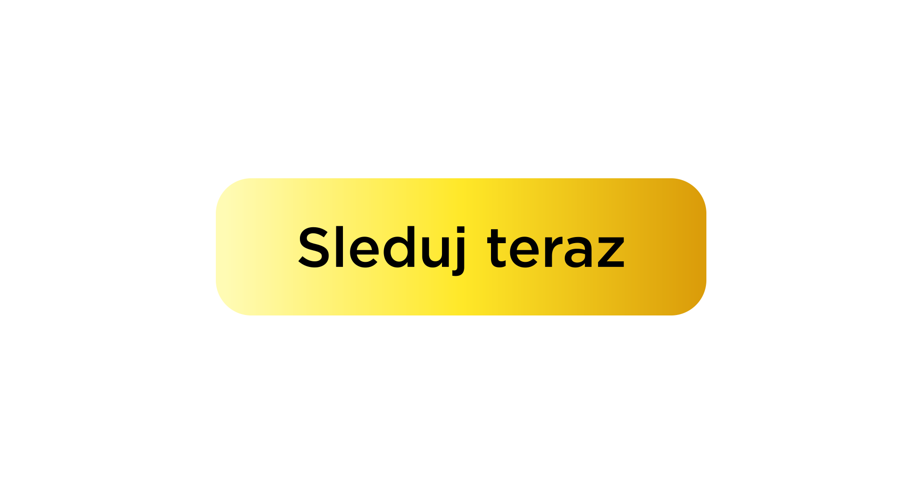
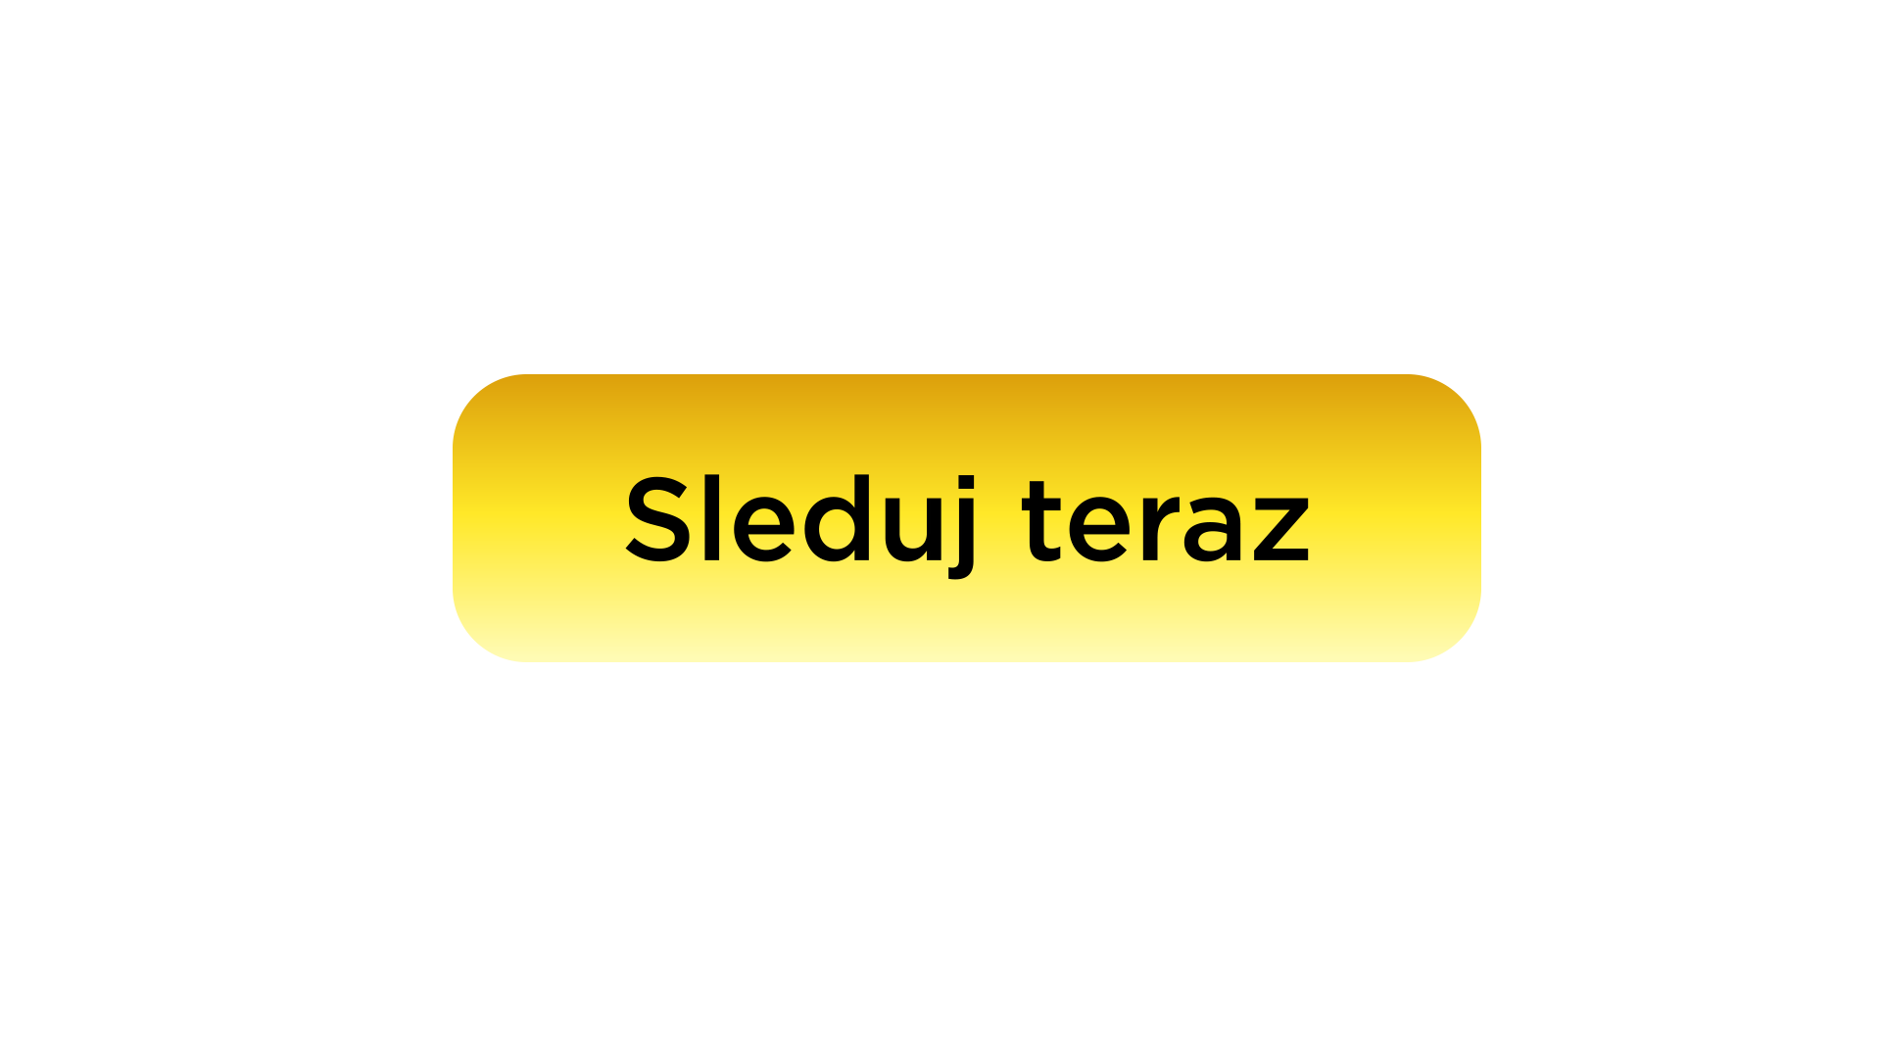
Call-to-Action (CTA)
CTA buttons use a gradient derived from the secondary colour palette.
The gradient can be applied horizontally or vertically depending on layout requirements.
Horizontal gradient
Vertical gradient
Ensure sufficient contrast and legibility across all backgrounds.

Slide 17
Chapter 5.3
Social Media

Slide 18
Social Media Role
Social media is not a promo channel.
It is where stories become moments and conversation.
SOCIAL MEDIA:
extends the life of stories
creates FOMO and cultural moments
turns viewers into a community
keeps VOYO present between premieres
Social = the cultural pulse of VOYO

Slide 19
Content First
On social, we don’t start with VOYO. We start with the story.
LEAD WITH:
moments
emotions
characters
turning points
NOT WITH:
feature lists
generic promo graphics
platform messaging
Story stops the scroll. Platform comes second.

Slide 20

Local & Culturally Fluent
VOYO must sound like it belongs here.
USE:
local humour
natural language
cultural references
real-time reactions
AVOID:
generic global tone
corporate language
Social should feel local, not imported.

Slide 21
Social Supports The Viewing Journey
Social keeps VOYO present across everyday viewing moments.
ANTICIPATE
know what’s coming and why it matters
DISCOVER
see what everyone is talking about
WATCH
join the moment while it’s happening
CONTINUE
stay connected between episodes
KEEP WATCHING
make VOYO part of everyday routine

Slide 22
Create FOMO. Protect The Experience.
In real time culture, moments spread instantly. If VOYO doesn’t lead the conversation, someone else will.
Our role is to own the moment while protecting the story.
BEFORE THE REVEAL
Build tension, not outcomes
emotion & reactions
suspense & questions
AT THE OFFICIAL REVEAL
Own the moment immediately
confirm results clearly
guide viewers on VOYO
AFTER THE REVEAL
Extend the conversation
reactions & debate
best moments & fan response
Content rules
Reality & sport → results spread instantly → lead the moment
Series & drama → protect the story → avoid plot spoilers
Create urgency, not spoilers. Lead the moment, don’t chase it.

